Slide 1

Data Analysis Portfolio Project
Analysis on Annual Financial data of a Pizza Store
By : Rutvi Gajipara

Slide 2
Outline :
Executive Summary
Introduction
Methodology
Results
Conclusion

Slide 3
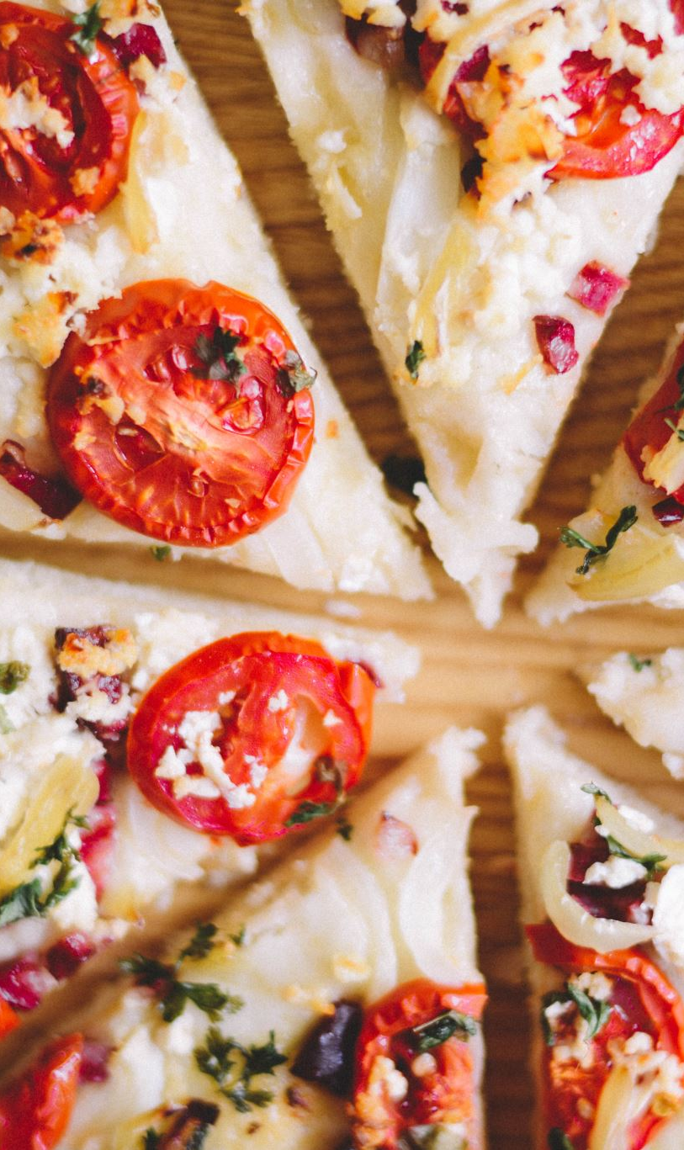
Executive summary
To be competitive in food industry, It’s essential to keep up with the ever-changing trends. This report uses data analytics to highlight top and worst chosen pizzas by customer over a year. The different aspects focused on to get accurate results was price, size, days orders were placed on and type of a pizzas.
Data was gathered from Kaggle public data sets. It was collected, cleaned, subjected to expletory analysis, and visualized on a dashboard.

Slide 4

Introduction
This presentation report uses data analytics to highlight top and bottom seller pizza by prize, size, quantity, type, total orders and share in the revenue.
The following inquiries were investigated using the data :
Which pizzas contributed most in the annual revenue?
Which pizzas contributed least in the annual revenue?
What are the days and months with highest and lowest sale?
The target audience for this research is anyone who want to learn about the financial data analysis in food industry.

Slide 5
Methodology
Data with several data types was gathered from Kaggle public data sets.
Excel functions such as Conditional formatting, formulas, Find & replace, Data validation, removing null and duplicate values, creating new columns to get name of the day and month from date were used for Data cleaning and validation purpose.
SQL queries were used to find insights of data such as Total revenue, Average order value, Total orders, and Daily and monthly trends etc.
Charts, graphs and Dashboard were created in PowerBI for visualization purpose.

Slide 6

Results :

Slide 7
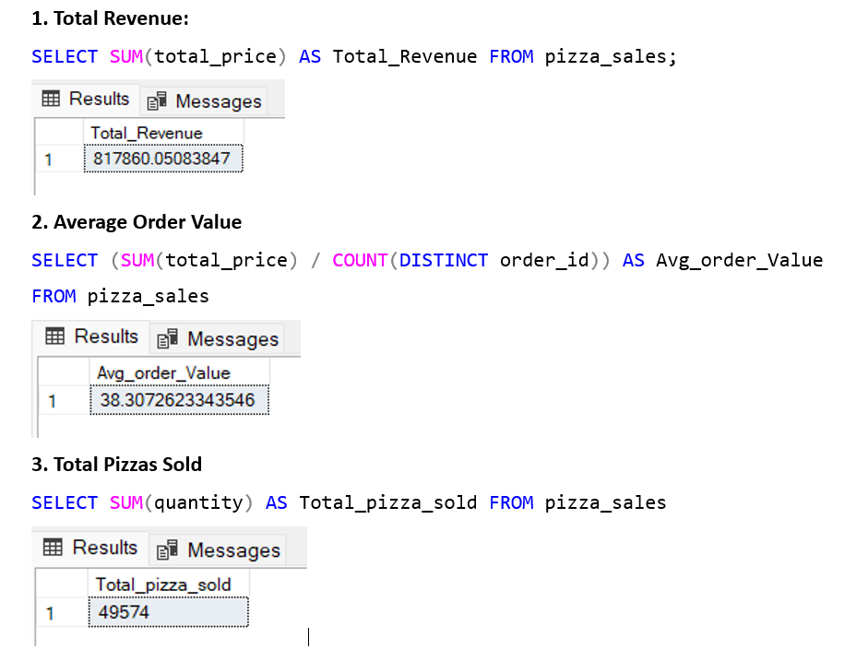
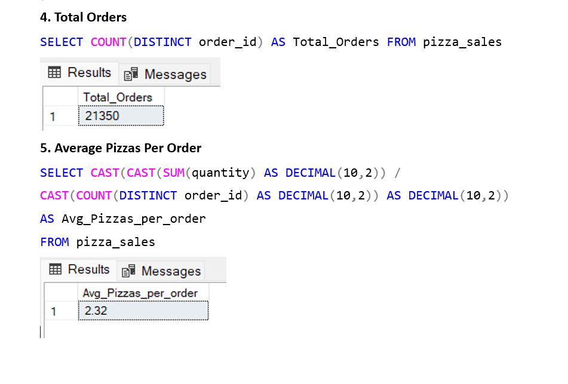
Important insights from SQL queries

Slide 8
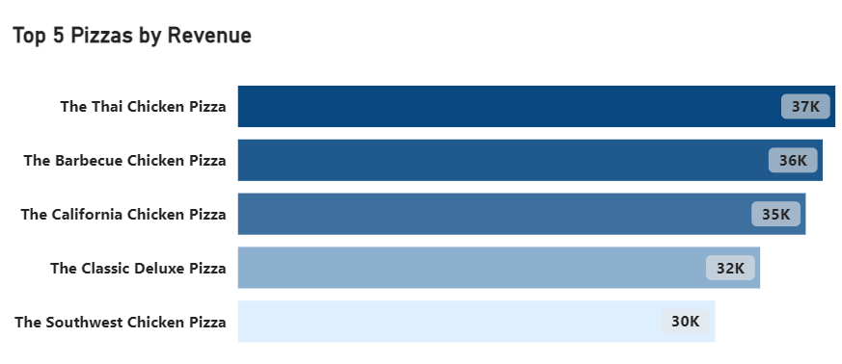
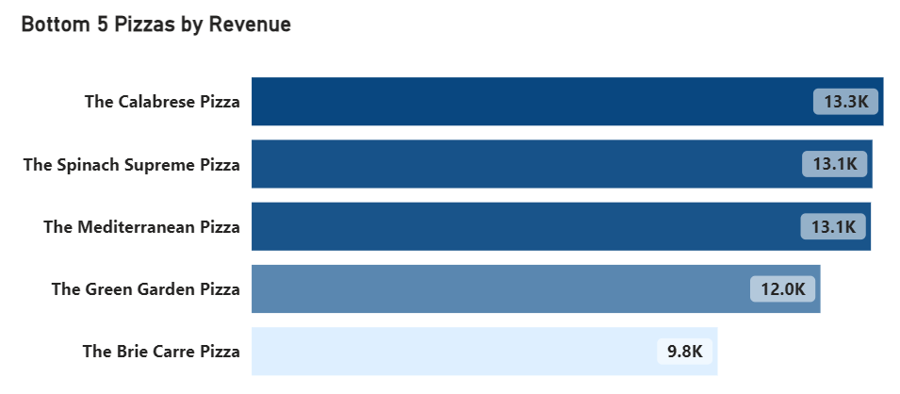
Top and bottom 5 pizzas by revenue

Slide 9
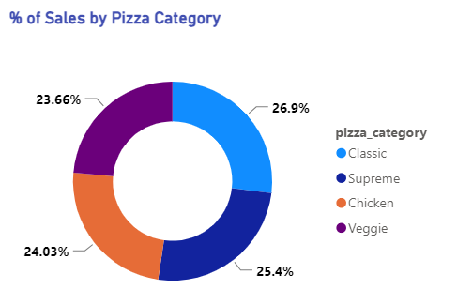
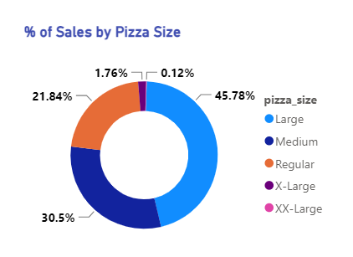
% of sales by pizza category and size

Slide 10
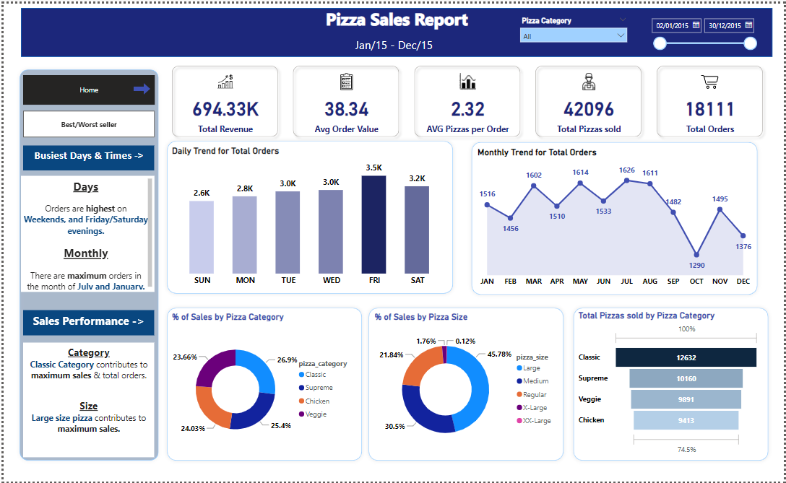
Power BI dashboard Tab 1
Pizza_Report.pbit

Slide 11
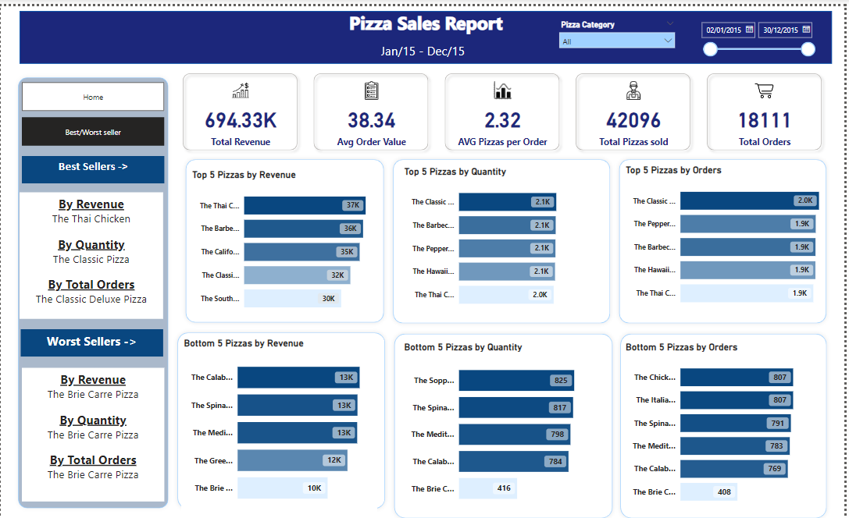
Power BI Dashboard Tab 2
Pizza_Report.pbit

Slide 12

Conclusion
Orders are highest on weekend evenings.
There were maximum orders in the months of July and January.
Classic Pizza category contributed maximum in the sales and total orders.
Large Pizza size contributed maximum in the sales.
The maximum orders were of Classic Deluxe Pizza and the least orders were of The Brie Carre Pizza.

Slide 13
End of Presentation
Thank you

